Slide 1

To The Mini Project-2 Presentation
Made By –
VANSHIKA BANSAL

Slide 2
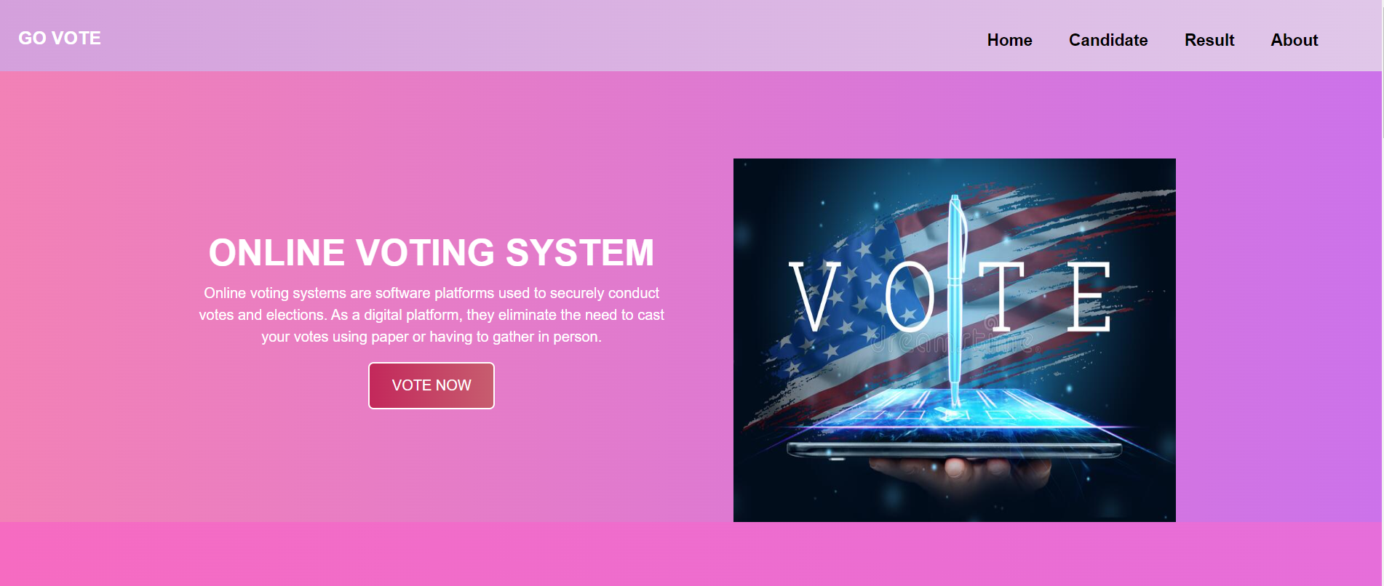

Slide 3
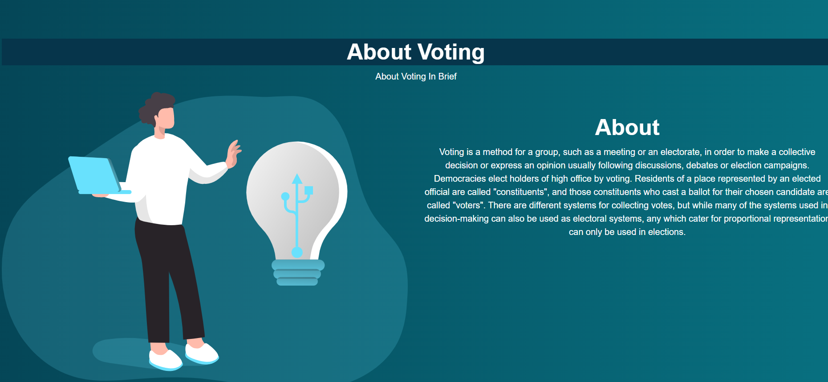
ONLINE VOTING SYSTEMS ARE SOFTWARE PLATFORMS USED TIO SECURELY CONDUCT VOTES AND ELECTIONS.

Slide 4
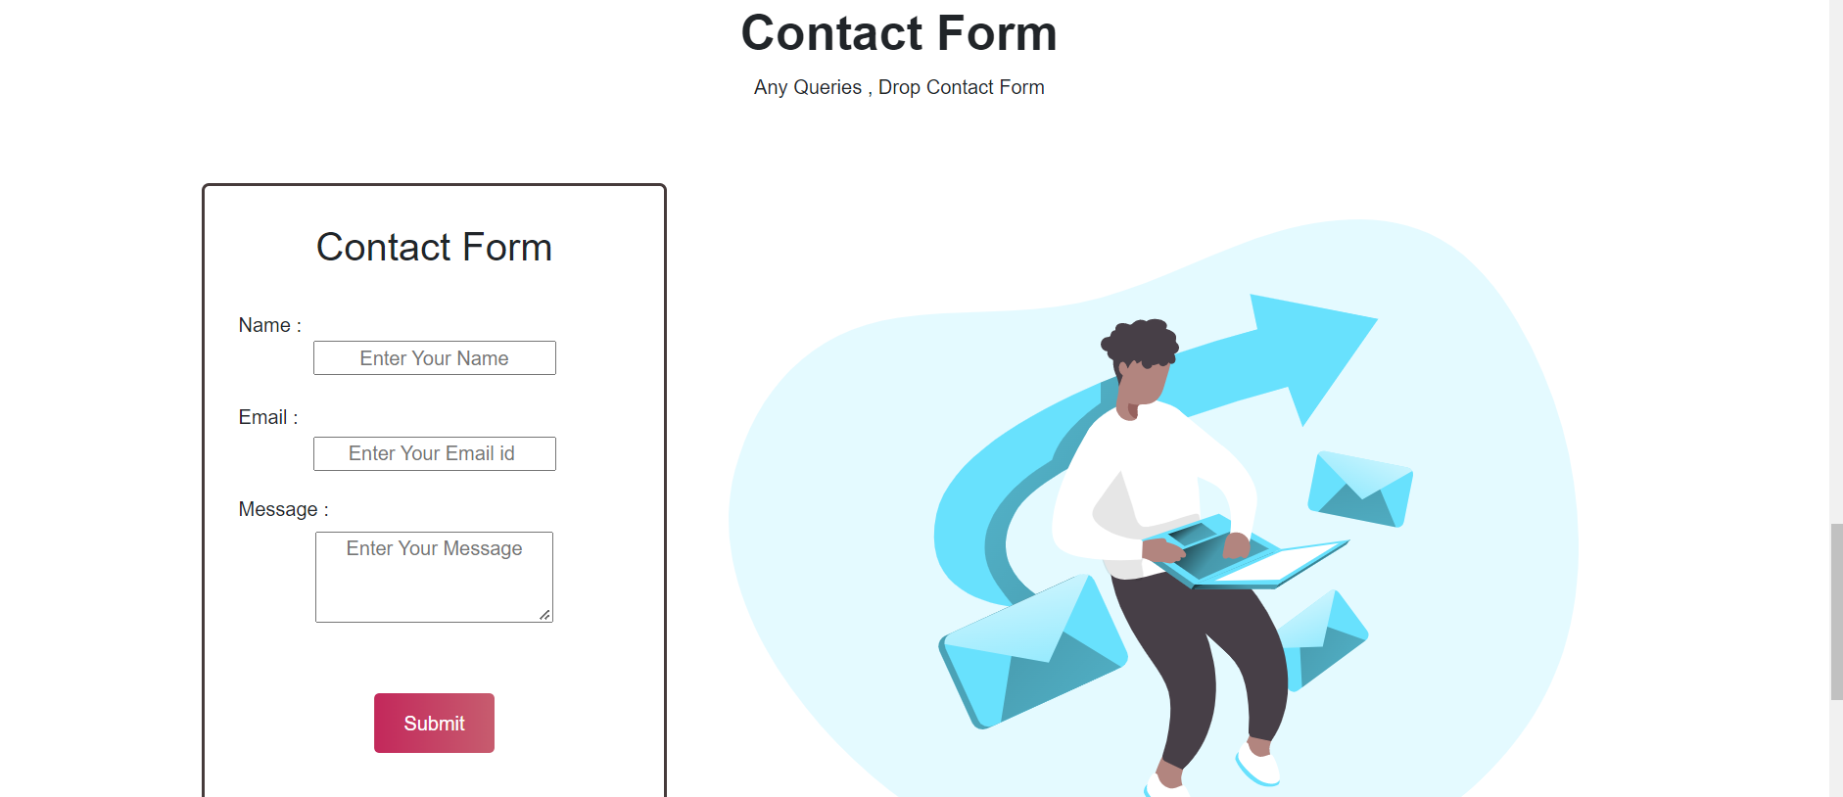
IN THIS WE CAN CONTACT TO THE ADMIN TO KNOW ABOUT VOTING THAT HOW TO AND TO WHOM WE CAN VOTE AND BY WHICH PROCESS.

Slide 5
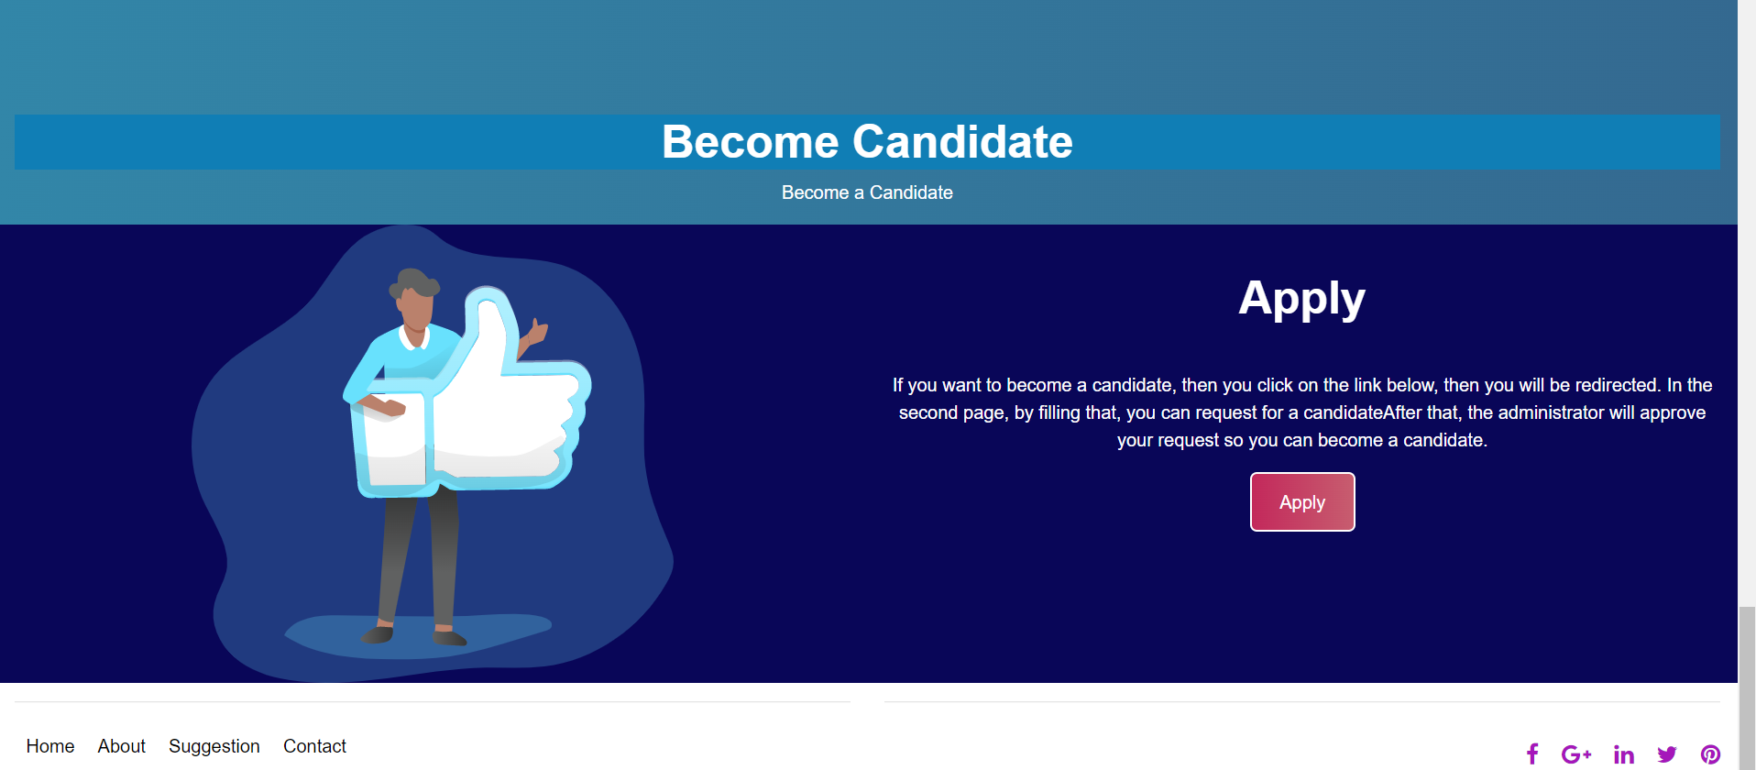
THIS IS THE APPLY PAGE. IN THIS PAGE WE CAN APPLY FOR VOTING. WE CAN APPLY FOR THOSE CANDIDATES WE WANT TO VOTE. BASICALLY WE ARE REGISTERING OUR NAMES IN THE LIST.

Slide 6
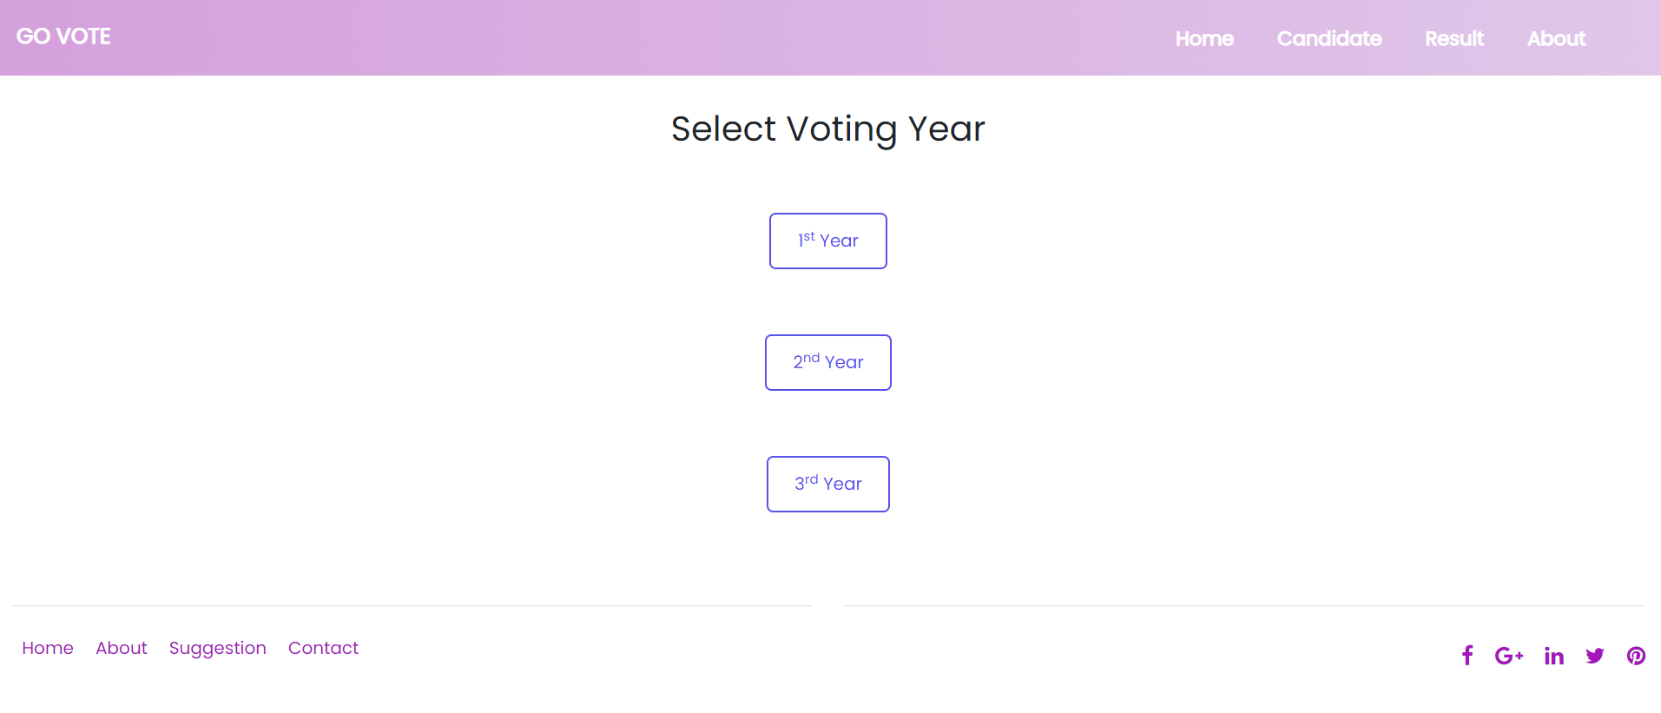
THIS IS THE CANDIDATE PAGE .IN THIS PAGE THERE ARE THREE YEARS TO WHICH WE CAN SELECT ANY ONE AND CAN VOTE FOR THAT PARTICULAR YEAR CANDIDATE.

Slide 7
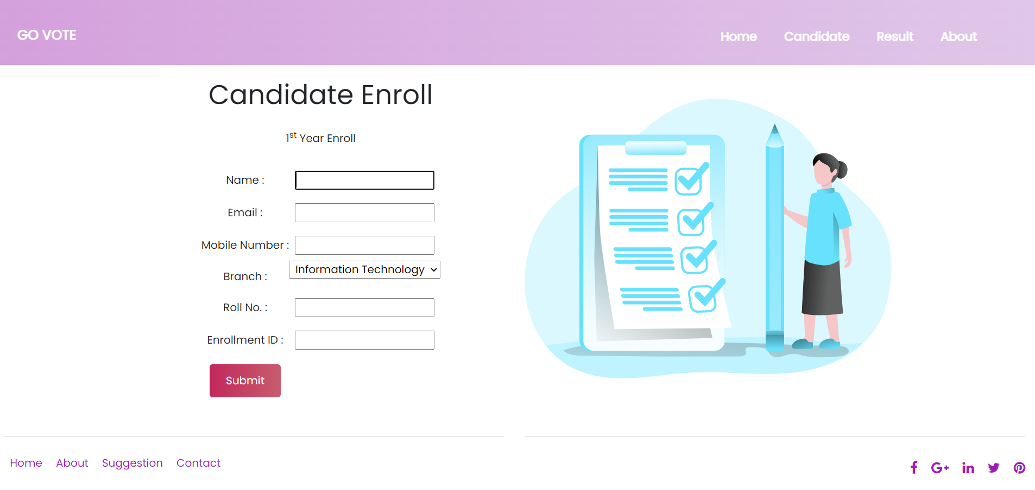
AFTER CLICKING ON APPLY BUTTON , A CANDIDATE ENROLL PAGE WILL BE SHOWN ON WHICH WE HAVE TO SELECT THE YEAR TO WHICH YEAR WE WANT TO VOTE.
AFTER CLICKING ON THE YEAR WE WILL COME ON THIS CURRENT PAGE.

Slide 8
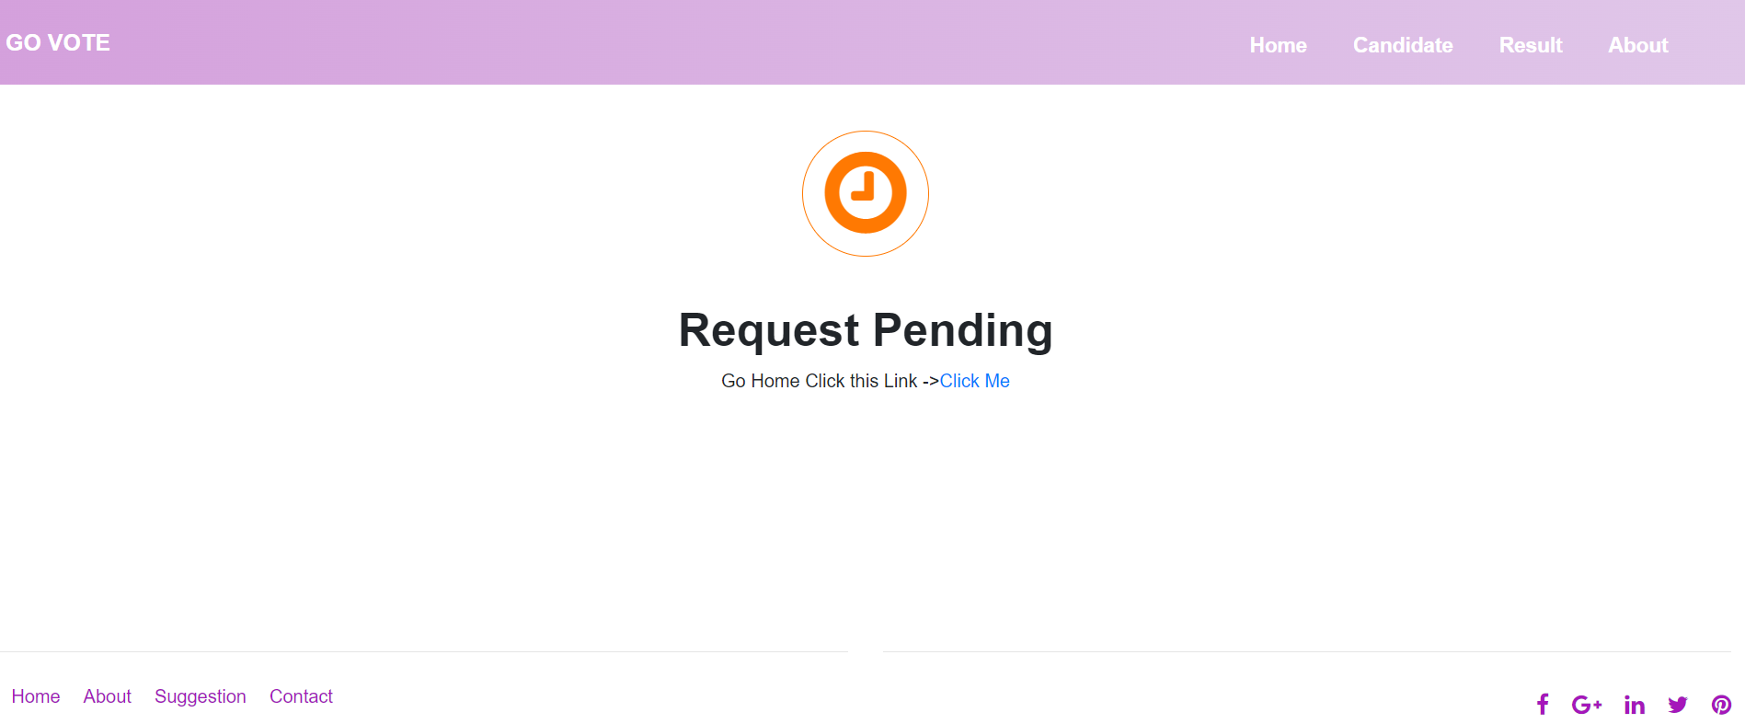
AFTER FILLING THAT ABOVE PAGE FORM WE WILL COME TO THIS PAGE WHERE IT IS SHOWN REQUEST PENDING AFTER WE CLICK ON CLICK ME BUTTON OUE REGISTERATION WILL GET SUCCESSFUL.

Slide 9
THIS IS THE CANDIDATE PAGE .IN THIS PAGE THERE ARE THREE YEARS TO WHICH WE CAN SELECT ANY ONE AND CAN VOTE FOR THAT PARTICULAR YEAR CANDIDATE.
AFTER THIS WE WILL COME TO THE NAMES OF THE CANDIDATE TO WHICH WE WANT TO VOTE.

Slide 10
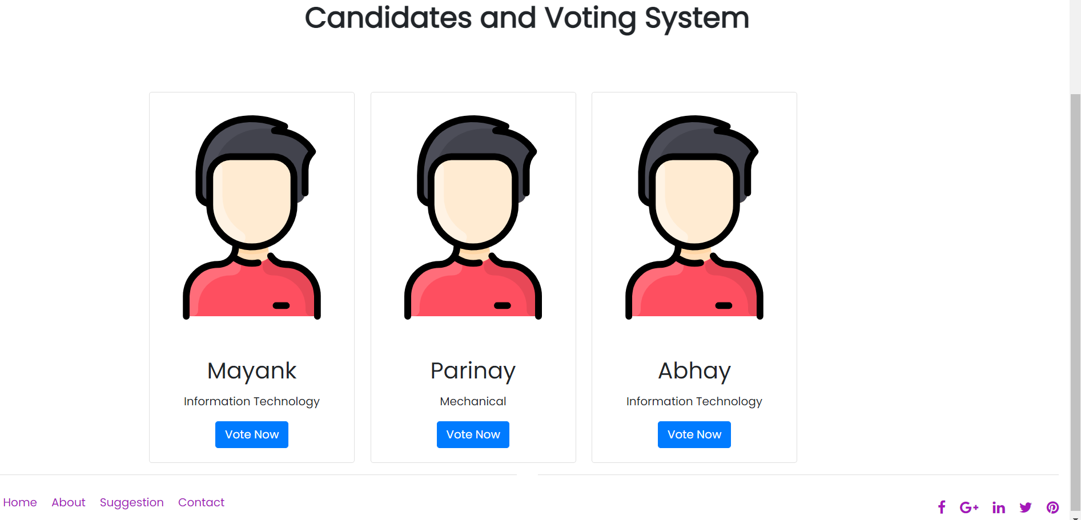
AFTER SELECTING THE THIRD YEAR CANDIDATE THIS PAGE WILL BE OPEN .NOW I CAN SELECT ANY ONE OF THE CANDIDATE WHICH I WANT TO VOTE.LIKE IF I CHOOSE PARINAY OF THIRD YEAR TO VOTE I WILL CLICK ON VOTE NOW BUTTON.

Slide 11
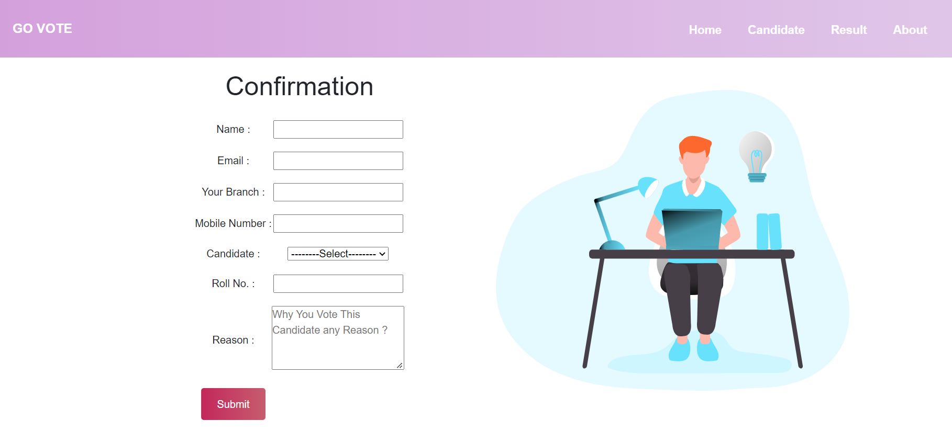
AFTER CLICKING ON VOTE NOW BUTTON FOR PARINAY. WE WILL COME ON THIS CONFIRMATION PAGE. BY FILLING THIS FORM WE WILL CONFIRM OUR NAMES IN THE LIST THAT WE ARE CONFIRM TO VOTE.

Slide 12
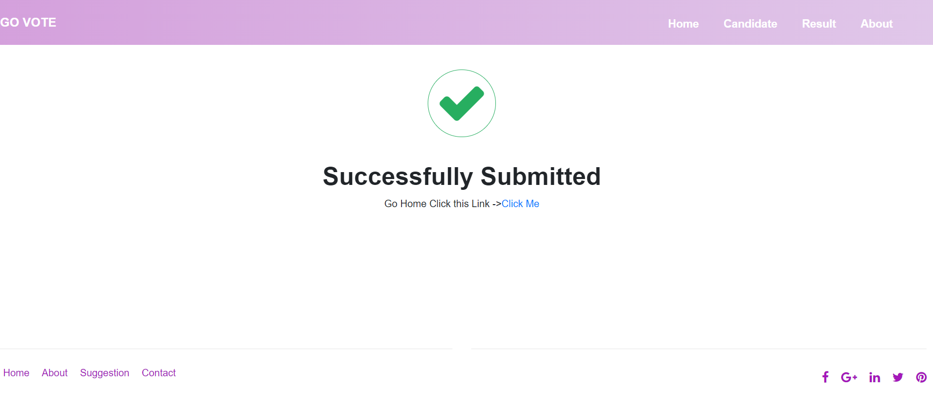
AFTER FILLING THAT CONFIRMATION FORM THIS SUCCESSFULLY SUBMITTED PAGE WILL BE SHOWN. AFTER CLICKING ON CLICK ME BUTTON WE WILL SUCCESSFULLY SUBMIITTED FOR OUR REGISTERATION.

Slide 13
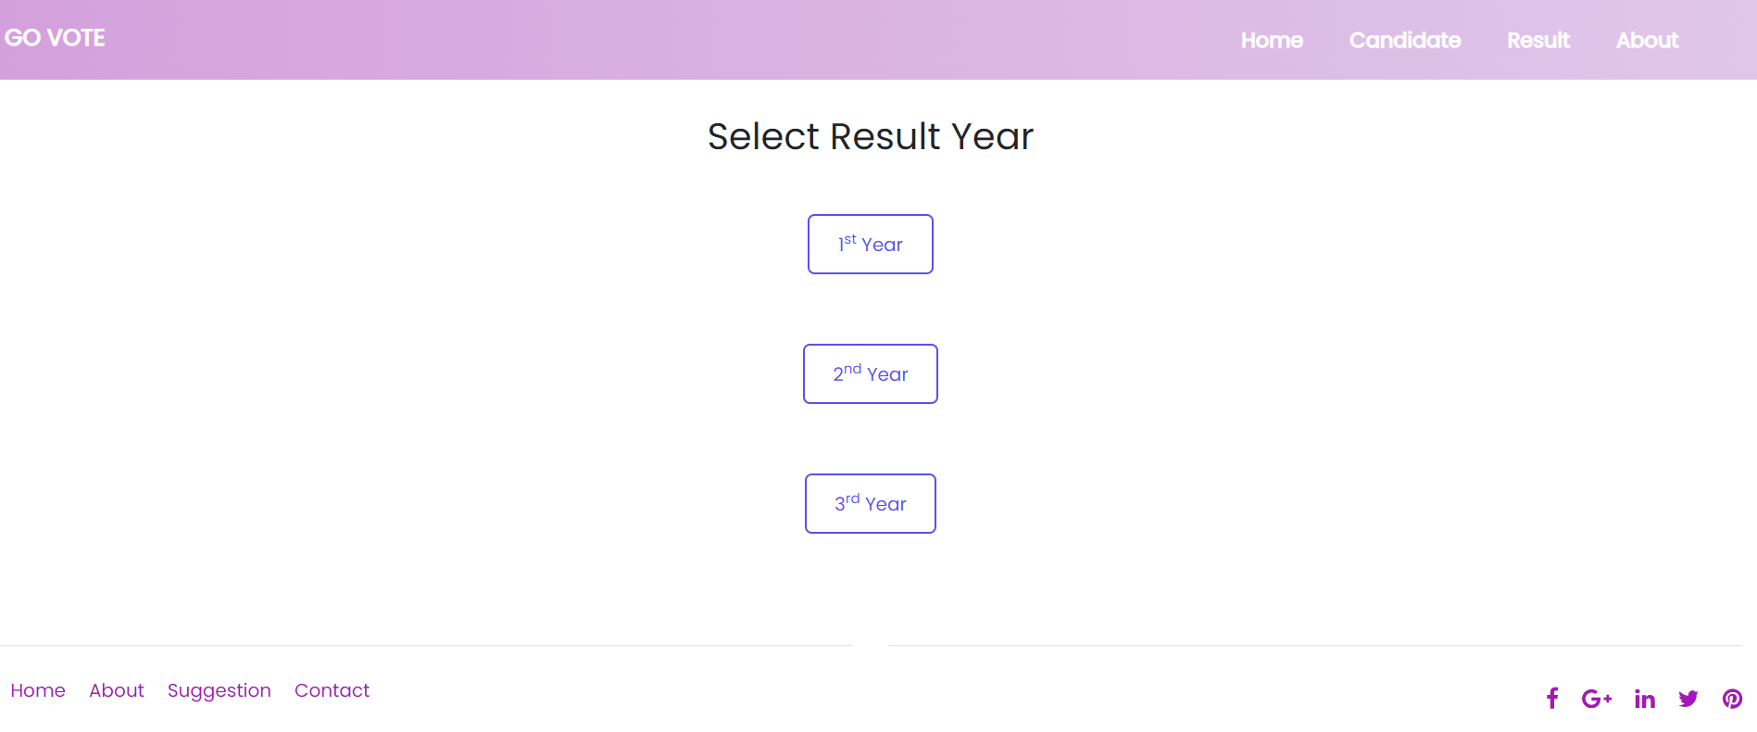
AFTER SUCCESSFULLY VOTING THE THORD YEAR CANDIDATE NOW WE WILL COME ON THIS RESULT PAGE. NOW WE WILL CLICK ON THIRD YEAR RESULT BUTTON TO SEE THE RESULTS.

Slide 14
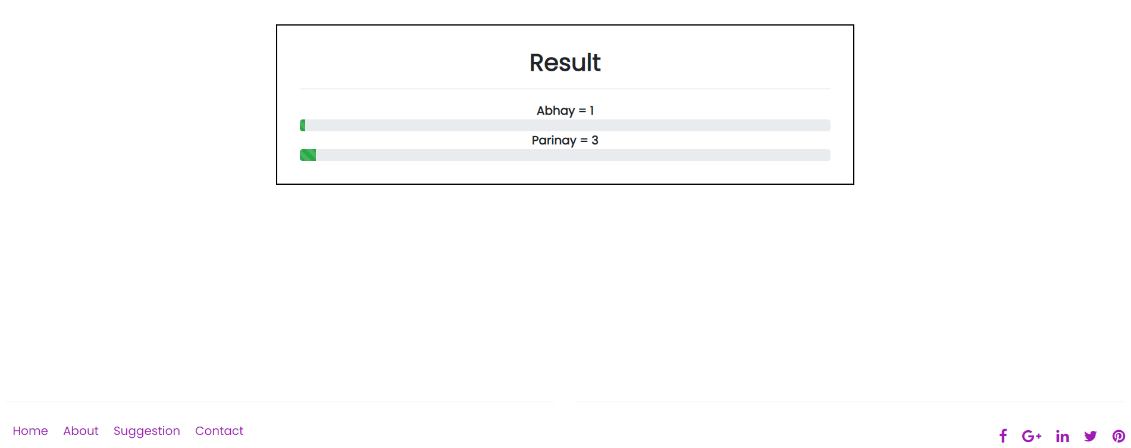
NOW WE CAN SEE THE RESULTS THAT AFTER VOTING FOR PARINAY WE HAVE GOT ONE EXTRA VOTE BECAUSE TWO VOTES WERE ALREADY GIVEN TO HIM.

Slide 15
THIS IS THE RESULT FOR THE USERS THAT WE HAVE REGISTERED.

Slide 16


